Slide 1
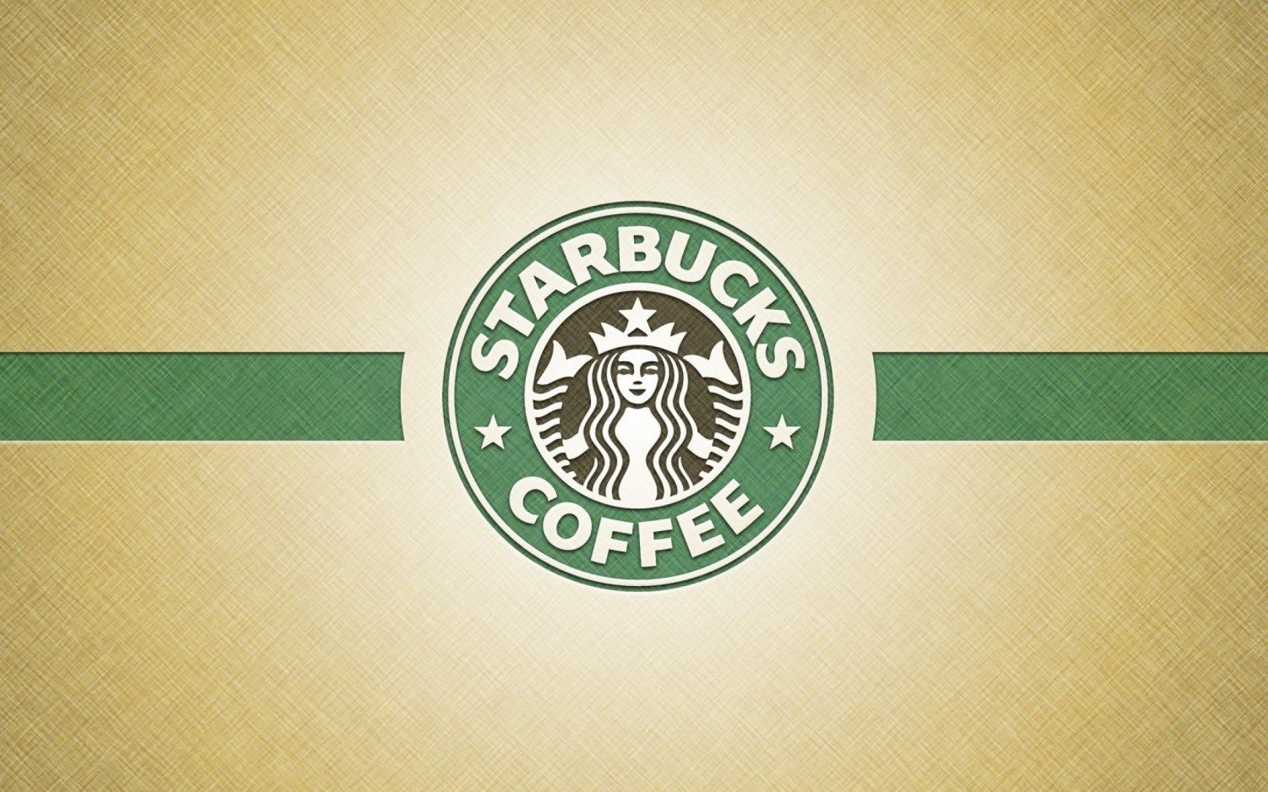
SUPPLY CHAIN MANAGEMENT
SUPPLY CHAIN REALITY
Sundar Arumugam Krishnan Nagarajan

Slide 2
Agenda / Topics
Starbucks product description
Starbucks is a retail company that deals with supply of coffee drinks around the world to its customers.
It is the largest coffeehouse in the world.
02
P A G E

Slide 3
Agenda / Topics
Starbucks product and customer range
Starbucks provide a greater product variety within each category. Customers believe that the product image and quality justify the purchase at a given price.
Number of range of customer growing as Starbucks has a strong brand image which customers associates it with high quality coffee and excellent customer care services.
03
P A G E

Slide 4
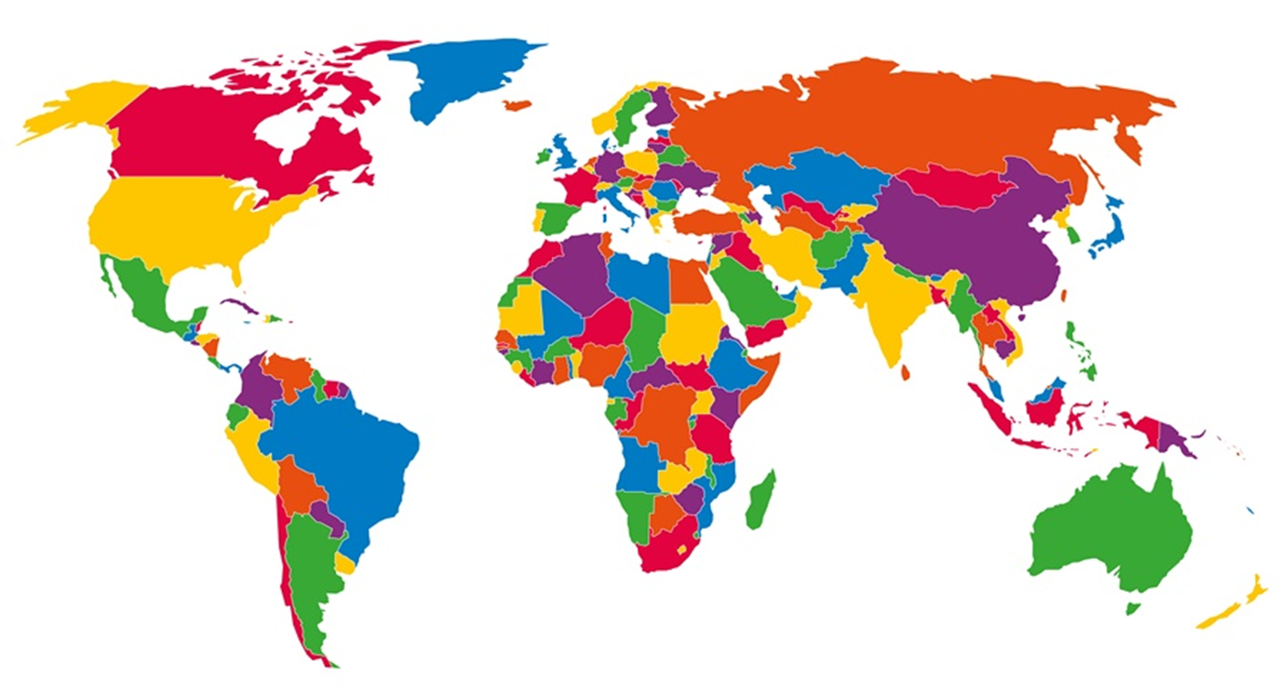
Supply chain look like geographically & what time does it take?
The company sources out its beans from nearly 30000 farms around the world this involving countries such as Kenya, Colombia Guatemala, Tanzania, Brazil, Mexico and Saudi Arabia.
The beans are then collected and taken to the six Starbucks’ storage facilities that are centrally located which make it possible to deliver to 25000 stores in 69 countries.
This has helped the company to be able to reach their clients in time.

Slide 5
Agenda / Topics
Supply chain & logistic mean more than just a necessary cost
Being a supply chain company, Starbucks logistics is essential to the delivery of the product as many customers would wish to have their coffee delivered to the in time thus it not a necessary cost but also an important aspect to the smooth running of the business.
As the product is also delivered to the consumers, it gives the company an advantageous opportunity from the customers as most prefer being brought their coffee to where they are rather than going to buy it from a stall.
05
P A G E

Slide 6
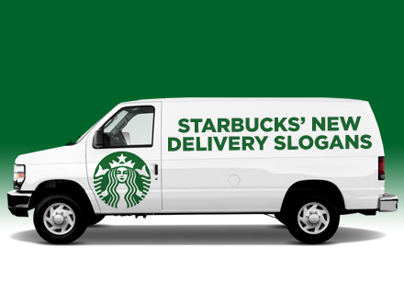
Agenda / Topics
Delivery time from the supplier to the company to the customer
The delivery from the supplier to the company usually done daily basis and with a tie of 48hours
06
P A G E

Slide 7
Agenda / Topics
Quality of logistics through “perfect order” metric
Since 2000 the company has offered fair trade which can be rate to 80%
Starbucks coffee is supplied in time with a percentage of 94% delivery on time whereby the 6% left is due any transport issues that are maybe caused by external factors.
The quality of products delivered to customers are always the company's top priority however it doesn’t mean there are not laybacks in the business thereby the company percentage of coffee delivered without damage is 98% or 9 on a scale rate o 1-10
The quantity delivered is always the exact a requested by the customers hence a percentage of 100%
07
P A G E

Slide 8
Agenda / Topics
Company operating based on orders
Starbucks operates based on orders as it deals with nonperishable goods thereby, they products are made on receiving of orders that are to be delivered to its customers.
08
P A G E

Slide 9
Agenda / Topics
Description of Starbucks over one year period
Like in the previous year, Starbucks sales went up as influenced by the covid-19 situation which led to many people to order for coffee through Starbucks thus raising the store sale growth from 6% in 2019 to 9% in 2020
Decision
The company has had instance of poor decision which can be evident right now as it decided to focus on growing instead of keeping its loyal customers which causes it to raise it prices therefore it become a steppingstone to its competitors.
09
P A G E

Slide 10
Agenda / Topics
Inventory management
To manage store level inventory, Starbucks uses an EOQ system which aids Starbucks to reduce stock decline and excess damage.
Therefore, with the both systems Starbucks therefore can place a 15% stock on inventory to warranty their client demand. The economic order quantity is place daily with a lead tie of 48hours.
010
P A G E

Slide 11
Agenda / Topics
NO out of stock situation (OOS)
With the above set conditions on how stock is stored it therefore hard for the company to run out of stock thus whenever our customers make an order, they are delivered with what they require.
011
P A G E

Slide 12
Agenda / Topics
Dead stock
Several instances where there is dead stock in Starbucks this is happens because,
where the order made by customers is cancelled or the customers are not reachable. It also happens when there is surplus make of coffee.
012
P A G E

Slide 13
Agenda / Topics
Bargaining power to both the suppliers and the customers & Power does the company have in negotiating the price over delivery conditions
Company has bargaining power to the suppliers in terms of pricing and to the customers in terms of delivery.
This was initiated by the company which had to sort out for suppliers of coffee thus bargaining on both supply time and price of coffee beans and on the other hand, the customers bargains with the company on which time is suitable for the delivery of their order products.
013
P A G E

Slide 14
Agenda / Topics
Forms of cooperating with the supplier
The company would only cooperate with the supplier only if
there is safe working conditions and no use of force or child labor.
014
P A G E

Slide 15
Agenda / Topics
Improvement needed
Starbuck is not able to keep up with the global growth of the company. This therefore results huge transportation expenses. Hence the growth of the company should be a topic of discussion
More than half of their orders are not delivered on time.
The Bargaining power from both suppliers and customers
015
P A G E

Slide 16
Profiling supply chain problem areas and critical issues | Estimation on scale 0-7
1. Demand is unpredictable (in quantity) | 2
Comments: it is quite predictable as the company already has its loyal customers therefore no need for buffering inventory
2. Demand trends are changing (in quality) | 6
Comments: for any business to thrive, risk taking must be a number one option but bearing in mind that at time outcomes are surprising there the company takes huge risk in accordance with the change of situation at hand
3. Level of competition | 7
Comments: although Starbucks is the leading retailing and roasting specialty it still has competition from upcoming retailors who also provides the exact product how am not sure of how many are they.
4. Physical damage and damage risks in supply chain processes | 5
Comments: Starbucks being a giant of retailing and roasting has its drawbacks in transportation especially when it is using other logistic services to make its delivery. Though the complexity of packaging is not a major issues as we use ecofriendly products to package our products
5. Order cycle length and uncertain delivery time | 6
Comments: with the challenges in logistics, delivery time is increased thus low delivery per day this causing great stock turn over.

Slide 17
6. Volatile market price | 6
Comments: price fluctuation has been a major challenge in the business as the company now is focusing on growing and trying to reach a global level therefore at time the price differs this brings about losing of customers as they will prefer to buy from the other retailers.
7. Relative cost level of transport | 7
Comments: the company transport cost is more important as the company cannot supply its products to its customers without having a legitimate channel of the product reaching them.
8. Stock holding expenses | 0
Comments: this is because the company already has its major stores that a centrally located hence it will not another store for holding inventory which might bring about an extra expense.
9. Perishable products | 7
Comments: as the company is dealing with perishable products, it is therefore advisable that the product maybe put in use as it has been produced thus avoiding going to waste. The company therefore operates based on order thus avoiding produce going to waste.
10. Out-of-stock consequences | 2
Comments: with the conditions applied between the suppliers and the company it is difficult to run out of stock however in case of external conditions causing the situation, the company can reach its customer and inform them of the of their current situation through its website.
11. Low willingness to cooperate with supply chain partners | 1
Comments: the company has a good relationship with its suppliers which is influenced by the set rules of the by the company towards cooperation with a given supplier.

Slide 18
Thank you !

